Slide 1

Addressing Brownfields in Alaska
Melinda Brunner
DEC Contaminated Sites Program
20th Annual Alaska Tribal Conference on Environmental Management
Anchorage, Alaska
October 30, 2014

Slide 2
What is a Brownfield?
Definition:
Real property, the expansion, redevelopment,
or reuse of which may be complicated by the
presence or potential presence of a hazardous
substance, pollutant, or contaminant.
Source: United States Environmental Protection Agency
Notes:
Funding May Be Provided for the Assessment and/or Cleanup of the Presence or Potential Presence of Indoor and Outdoor Contaminants at Brownfield Properties

Slide 3
Underutilized Land or Building
Plan to Use the Land or Building for Something Different
Brownfield
Known or Suspected Contamination
What Three Ingredients Make a Brownfield?

Slide 4
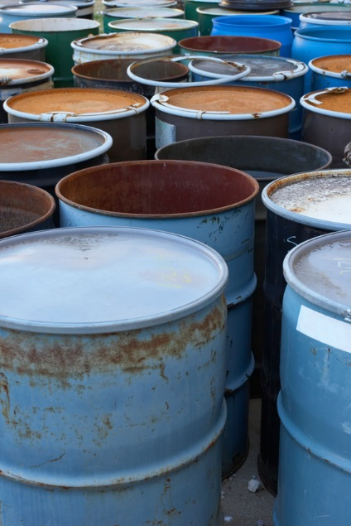
What types of Alaskan properties could be brownfields?
Abandoned tank farms
Old BIA schools
Old canneries
Former military sites
Former drycleaners
Former gas stations
Many more!

Slide 5
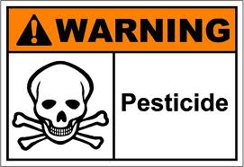

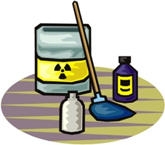
What substances might contaminate Alaskan brownfields?
Gasoline
Diesel
Asbestos
Lead
Solvents
Pesticides
Many more!

Slide 6

What types of things could Alaskan brownfields be turned into?
Community garden
Tribal hall
City offices
Subsistence resources gathering area
Playground
Housing development
Many more!

Slide 7
Why is it good to identify and reuse brownfields?
Environmental Benefits
Cleanup removes contaminants, protecting human health and the environment
Cleanup lessens the likelihood of contaminants migrating off-site
Keeps other land pristine by reusing land that was previously developed
Can restore land so that it’s safe for food production

Slide 8
Why is it good to identify and reuse brownfields?
Economic Benefits
Reuse of existing structures helps keep costs down
Reusing a brownfield can raise the value of neighboring properties
Increased employment opportunities

Slide 9
Why is it good to identify and reuse brownfields?
Social Benefits
Improved community health, safety and security
Creates opportunities for development in core areas of communities
Can provide opportunity for traditional lifestyle activities by restoring subsistence resources

Slide 10
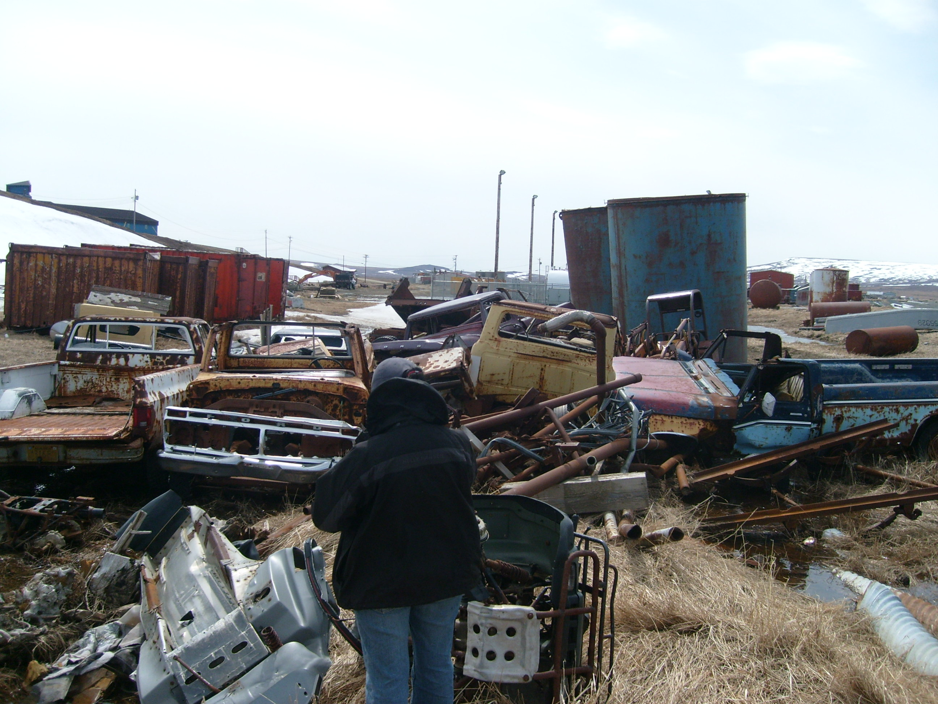
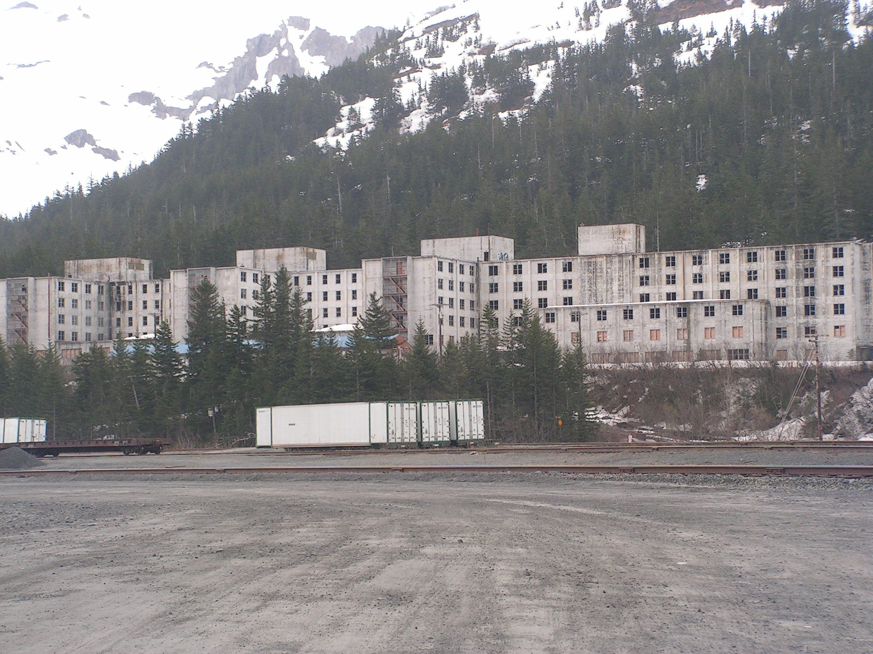
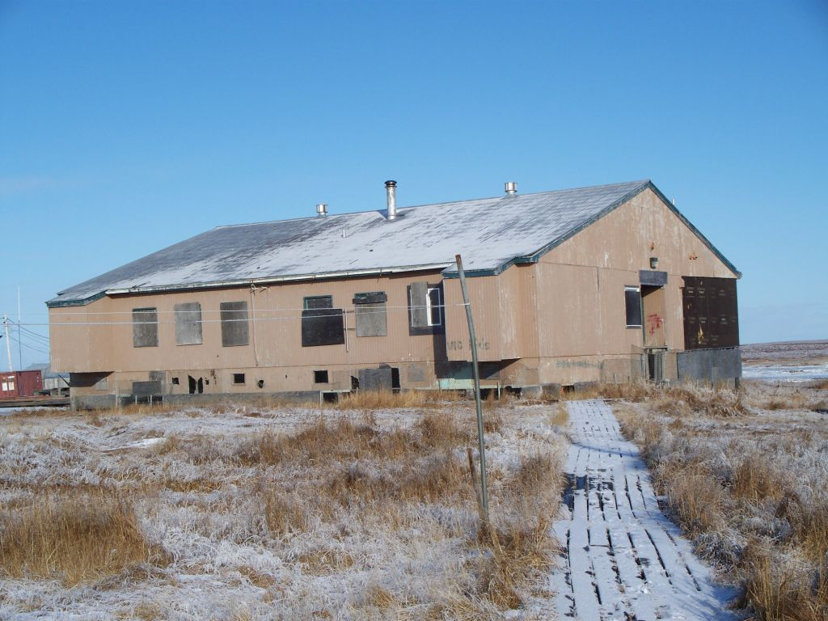
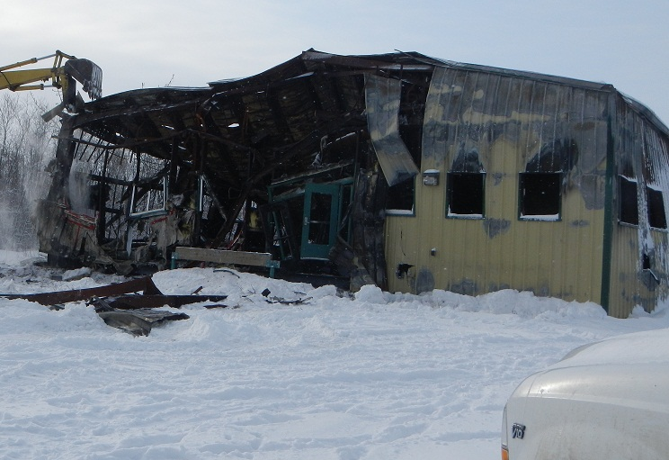
Are there brownfields in your community?
Tununak – Former Tank Farm
Whittier – Former Army Barracks
Newtok – Old BIA School
Kwethluk – Burned Community Center
Notes:
-The General Accounting Office estimates that there are over 400,000 Brownfields nationally
-More recently, one study concluded that there are over 500,000 Brownfields – not including gas stations.
The 17 Brownfields pilots within our four States have estimated that they have 8500 Brownfields collectively within their jurisdictions.

Slide 11
We want to
assess or
cleanup
our brownfield!
What help is available from DEC?

Slide 12
DEC’s Brownfield Assessment & Cleanup (DBAC) Program
Services, not dollars, are awarded
Services are free
Services can be assessment or cleanup related
Competitive
Applications due January 30, 2015
For more information visit http://dec.alaska.gov/spar/csp/brownfields.htm#assess

Slide 13
Which entities are eligible for DBAC assessment or cleanup services?
Public, quasi-public, and non-profit entities such as:
Tribes
City and borough governments
Non-profits
State agencies
Community development organizations

Slide 14
What sites are typically eligible for DBAC assessment or cleanup services?
Sites that are publicly owned.
Sites that have no viable responsible party.
Sites that are not federally owned.
Privately owned sites are not usually eligible, unless the owner is not a viable responsible party and the project
will significantly benefit the public.

Slide 15
Strong applications will have:
A project team representing multiple organizations.
Documented community support for the project.
Planned reuse or redevelopment for the site(s).
Other project funding or in-kind contributions in place.

Slide 16
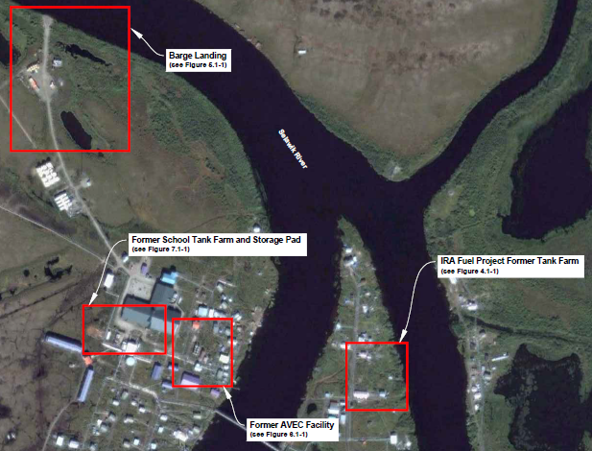
Selawik Areawide
Property Assessment and Cleanup Plan
Native Village of Selawik Received:
Ownership History
Land Use History
Potential Sources of Contamination
Sampling Results
Data Gaps
Clean Up Cost Estimates
Recommendations
Potential Funding Sources for Cleanup and Redevelopment

Slide 17
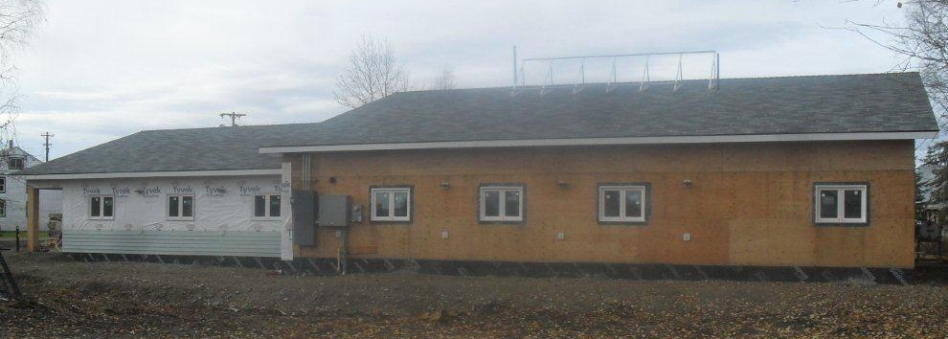
McGrath Site Characterization
McGrath Native Village Council was the successful applicant
Site of destroyed community center
DEC removed a heating oil tank and associated contaminated soil, and analyzed soil samples
City of McGrath obtained CDBG and MNVC obtained ICDBG for new center; total cost of building over $2 million

Slide 18
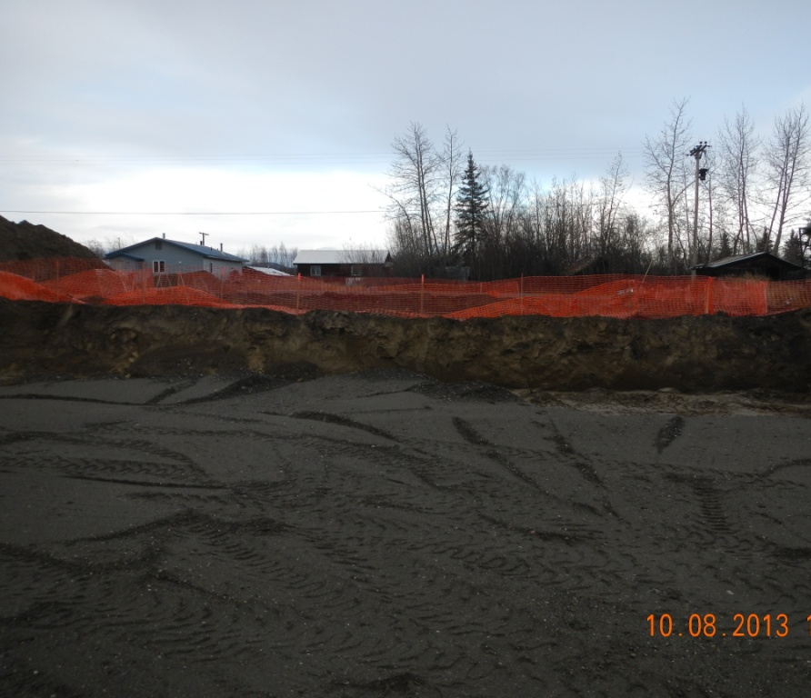
Tanana Site Characterization & Landfarm Management
City of Tanana provided equipment & labor for soil removal
DEC provided soil sampling and landfarm management plan
Project reporting included recommendations for addressing vapor intrusion during construction of the new building

Slide 19
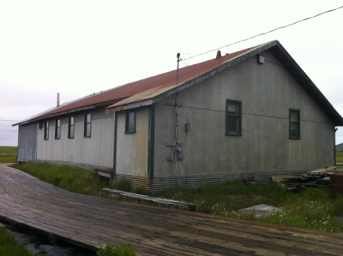
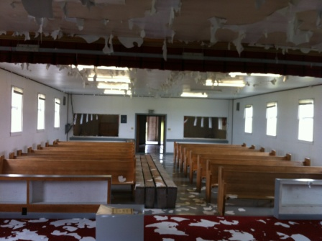
Kwigillingok Hazardous
Building Materials Survey
Old Moravian Church
Native Village of Kwigillingok wished to reuse the structure for youth activities, but had concerns about contamination
DEC provided sampling for asbestos-containing materials and lead-based paint, as well as recommendations for future use

Slide 20
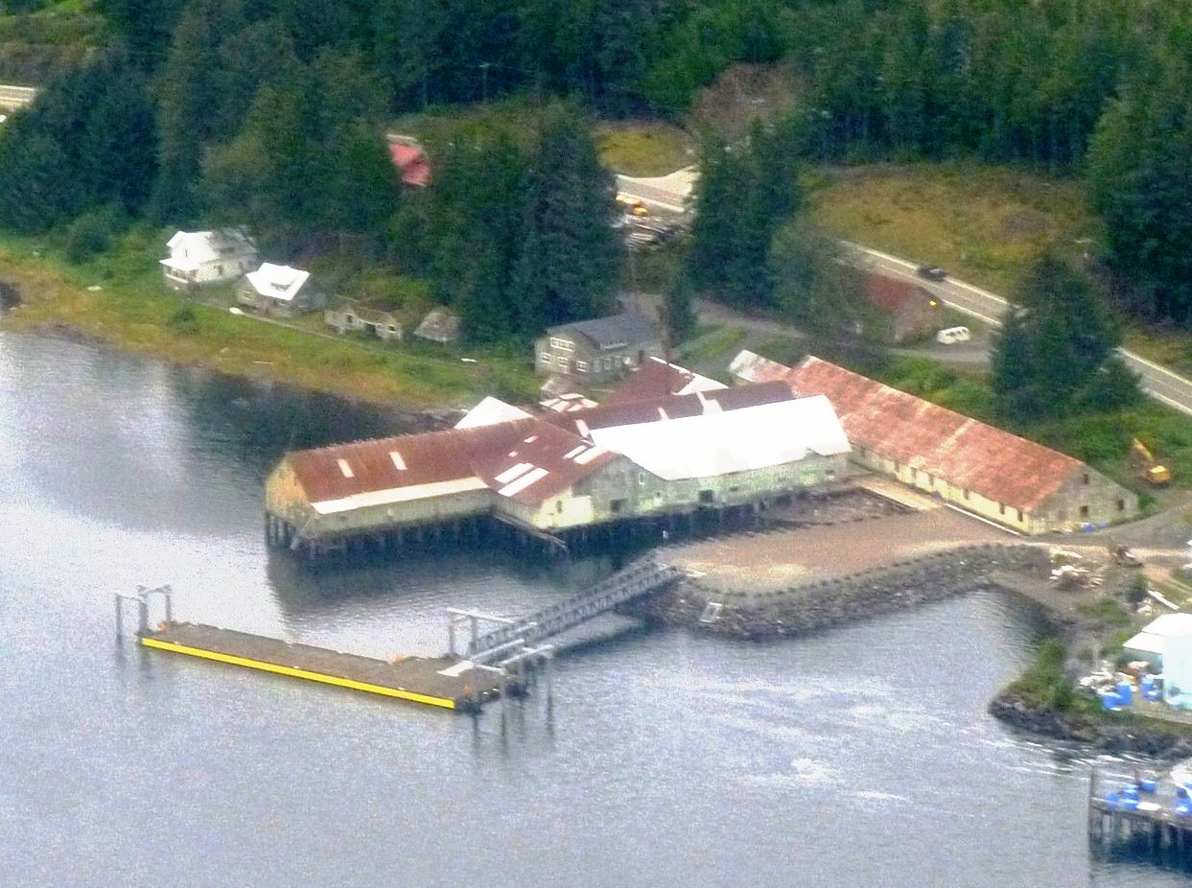
Kake Site Assessment
Former Keku Cannery
Organized Village of Kake needed information about the building so that they could pursue assistance from other sources to stabilize the building
DEC provided a Phase I site assessment, a hazard and risk evaluation, and a remediation cost estimate

Slide 21
Questions?
Melinda Brunner, Environmental Program Specialist
Contaminated Sites Program
Division of Spill Prevention and Response
Telephone: (907) 451-5174
Email: melinda.brunner@alaska.gov
http://dec.alaska.gov/spar/csp/brownfields.htm

